Slide 1
Artificial intelligence
Glena Aziz qadir

Slide 2
Data Types
3- Boolean: Boolean variables can have only two values: True and False
print(10 > 9)
print(10 == 9)
print(10 < 9)
print(bool(“Hello"))
print(bool(10))

Slide 3
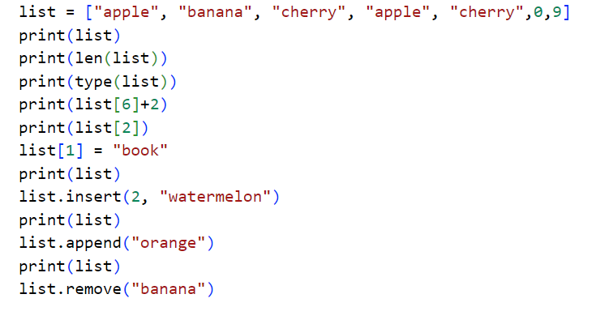
Data Types
4- List: Lists are used to store multiple items in a single variable.

Slide 4
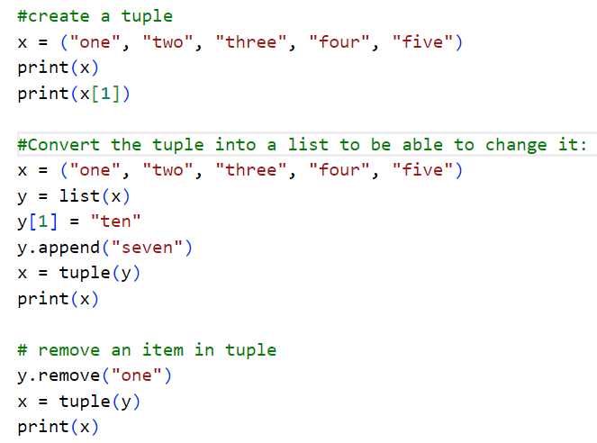
Data Types
5- Tuples are used to store multiple items in a single variable.
Tuple items are ordered, unchangeable, and allow duplicate values.

Slide 5
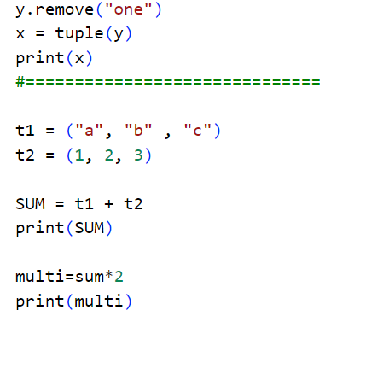

Slide 6
Python Indentation
Indentation refers to the spaces at the beginning of a code line.
Where in other programming languages the indentation in code is for readability only, the indentation in python is very important.
Python uses indentation to indicate a block of code.
The number of spaces is up to the programmer(it has to be at least one)
You have to use the same number of spaces in the same block of code.
if 5 > 2: print("five is greater than two!") if 5 > 2: print("five is greater than two!")

Slide 7
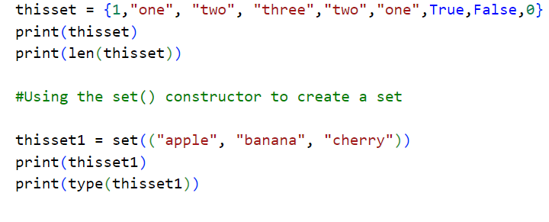
Data Types
6- set:
Sets are used to store multiple items in a single variable.
A set is a collection which is unordered(the items in a set do not have a defined order), changeable(the items can be changed after the set has been created), and unindexed, doesn’t allow duplicates.

Slide 8
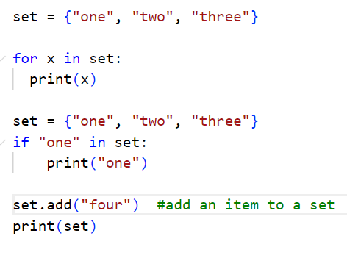
Cont…
Items can not be accessed in a set by referring to an index or a key.
But you can loop through the set items using a for loop, or ask if a specified value is present in a set, by using the in keyword.

Slide 9
Set Methods
Method | Description
add() | Adds an element to the set
clear() | Removes all the elements from the set
copy() | Returns a copy of the set
difference() | Returns a set containing the difference between two or more sets
difference_update() | Removes the items in this set that are also included in another, specified set
discard() | Remove the specified item
intersection() | Returns a set, that is the intersection of two other sets
intersection_update() | Removes the items in this set that are not present in other, specified set(s)
isdisjoint() | Returns whether two sets have a intersection or not
issubset() | Returns whether another set contains this set or not
issuperset() | Returns whether this set contains another set or not
pop() | Removes an element from the set
remove() | Removes the specified element
update() | Update the set with the union of this set and others

Slide 10
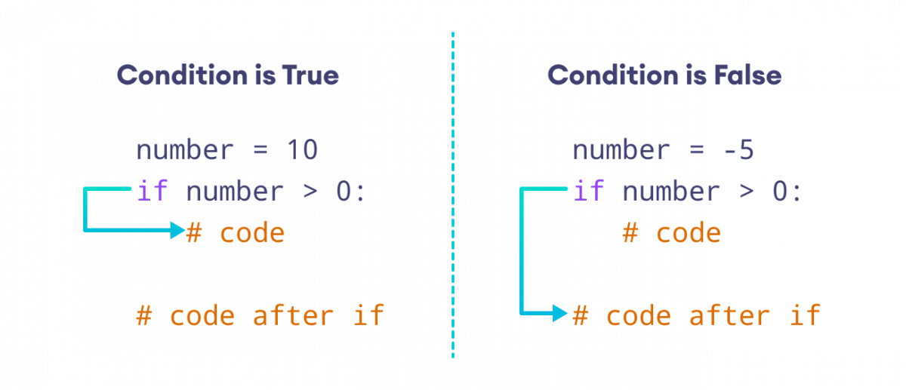
Conditional statements
if statement is written by using the if keyword.
if statement is a conditional statement. It is used to execute a block of code only when a specific condition is met.

Slide 11
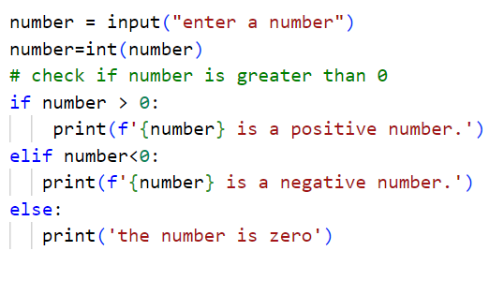
e.g.:

Slide 12
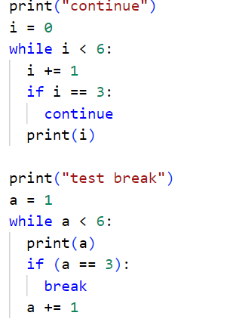
Loop in python
There are two ways to create loops in Python: the for-loop and the while-loop.
Python while loop is used to execute a block of statements repeatedly until a given condition is satisfied.
Continue statement can stop the current iteration, and continue with the next
break statement can stop the loop even if the while condition is true

Slide 13
Loop in python
For loops are used when you have a block of code which you want to repeat a fixed number of times.
The for-loop is always used in combination with an iterable object, like a list or a range.
The python for statement iterates over the members of a sequence in order, executing the block each time.

Slide 14
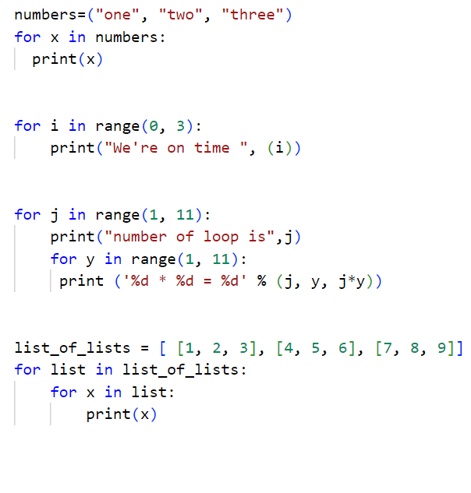

Slide 15
Functions
A function is a block of code which only runs when it is called.
def my_function():
print("hello from a function")
Information can be passed into functions as arguments.
Arguments are specified after the function name, inside the parentheses.
my_function("Emil")
If the number of arguments is unknown, add a * before the parameter name
def my_function(*names):

Slide 16
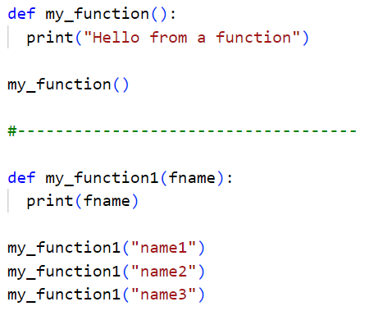

Slide 17
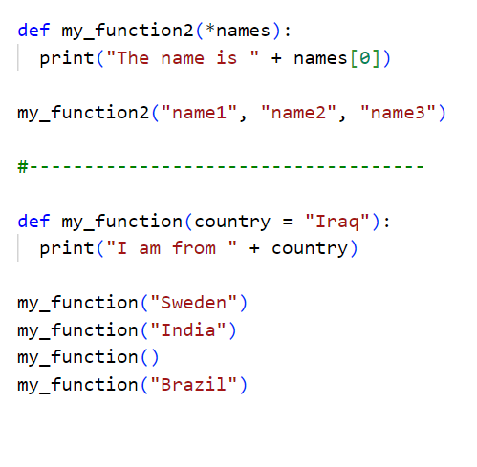

Slide 18
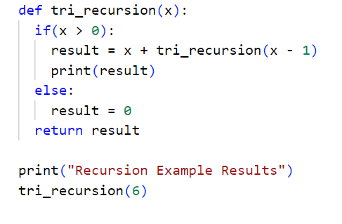
E.g:

